Slide 1


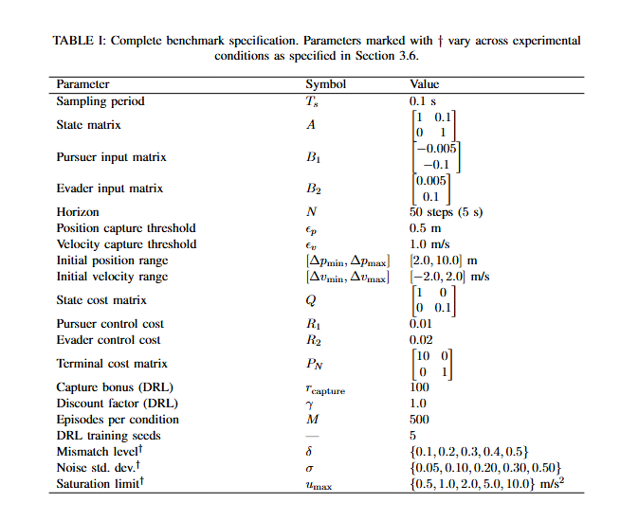
Model-Based and Learning-Based Pursuit-Evasion Control: A Benchmark Comparison of Linear-Quadratic Game Theory and Deep Reinforcement Learning
Blaine Swieder, Department of Electrical & Computer Engineering, Tennessee Technological University
Abstract
This thesis aims to develop a controlled pursuit-evasion benchmark for comparing two controller-design philosophies on the same system. More specifically, an exact finite-horizon linear-quadratic (LQ) dynamic game controller and a learning-based pursuer that is trained from sampled interaction. The benchmark is formulated in one-dimensional relative coordinates, with shared dynamics, shared state variables, and shared evaluation metrics. The analytical baseline is derived from a zero-sum finite-horizon game, while the learned controller is trained against the fixed Nash evader that is generated by the same Riccati sweep. The objective is not to propose a new RL algorithm, rather, it is to formulate a benchmark in which learned behavior can be judged directly against an exact game-theoretic reference. The thesis is organized around nominal performance and structured perturbations including model mismatch, additive process noise, and actuator saturation.
Benchmark Overview
This thesis utilizes a controlled one-benchmark pursuit-evasion benchmark to compare a learned controller against an exact analytical baseline on the same system.
The benchmark is formulated in relative coordinates, so the state keeps only quantities that matter for pursuit, relative distance and relative speed.
Both agents are modeled as double integrators over a finite, fixed horizon, which keeps the benchmark simple enough for exact analysis while maintaining nontrivial adversarial behavior.
The benchmark is intended to be low-dimensional so that the differences between model-based and learning-based control can be interpreted cleanly as opposed to being hidden by unnecessary environmental complexity.
Analytical Reference Controller
The analytical baseline is the exact finite-horizon linear-quadratic saddle-point controller for the benchmark.
It is computed by a backward Riccati sweep that produces both the pursuer gains and the fixed Nash evader gains.
This controller provides the model-based reference policy used throughout the study.
Since it is exact under the nominal benchmark assumptions, it gives the assumptions, it gives the comparison a principled standard rather than a heuristic baseline.
Learning-Based Controller
The learning-based controller is a PPO-trained pursuer operating on the same benchmark that used by the analytical baseline.
The learner only observes the relative state and a scalar reward and is not given the benchmark matrices directly.
During training, the evader is fixed as the Nash state-feedback policy generated by the analytical solution.
This causes the learning problem to be a single-agent MDP induced by a stationary adversarial response.
Motivation and Research Gap
Autonomous Vehicle interaction is fundamentally multi-agent; more specifically, lane changes, merges, and collision avoidance rely on the behavior of other agents.
Pursuit-Evasion games offer a natural adversarial abstraction for such interactions.
The literature shows that classical dynamic-game papers usually provide analytical solutions without a learning comparison, while RL pursuit-evasion papers typically report learned behavior without comparing against an exact analytical baseline on the same dynamics.
The objective of this thesis is to address this gap by formulating a benchmark that can be used to evaluate against an exact LQ saddle-point controller.
Differences in this Design
Most pursuit-evasion RL literature do not compare learned behavior against an exact analytical optimum on the same dynamics.
This thesis fixes the benchmark first, derives the exact controller, and then trains the learning-based pursuer on the same system.
This makes the comparison more interpretable, since the two methods are judged under shared dynamics, shared state variables, and shared evaluation conditions.
Therefore, the contribution is not a novel RL algorithm, but a controlled benchmark for comparing learning-based and model-based control directly.
Research Questions
Can a learned pursuer recover behavior close to the exact LQ saddle-point controller on the nominal benchmark?
How should learned performance be interpreted when the analytical benchmark is available on the same system?
How do the two controller classes respond when the assumptions supporting the analytical design are weakened?
Which perturbations most clearly expose the difference between model-based optimality and learning-based adaptation?
What are the Next Steps of this Research?
The next step is to complete the full simulation study under nominal conditions and structured perturbations.
These perturbations include model mismatch, additive process noise, and actuator saturation.
The final objective will be to measure how closely the learned pursuer approaches the analytical baseline and how both designs degrade when nominal assumptions are weakened.
References
T. Basar and G.J.Olsder, Dynamic Noncooperative Game Theory, 1999
J. Schulman et al. “Proximal Policy Optimization Algorithms,” 2017
X. Yang et al., “A Review of Reinforcement Learning Approaches for Pursuit-Evasion Games”
K. Wan et al. “Multi-Agent Pursuit-Evasion Game Decision-Making Using Deep Reinforcement Learning”
Z. Xu et al., “Pursuit and Evasion Strategy of a Differential Game Based on Deep Reinforcement Learning

